Slide 1
COS3302 Applied Data Science
Week 8 : Decision Tree and Random Forest
Jutharat Pooamorn
6405003317

Slide 2
Objectives
Use the Iris Dataset as a case study to enhance data analytics and data visualization
Tools : Correlation Matrix
Tuning the parameters of Decision Tree and Random Forest Algorithm

Slide 3
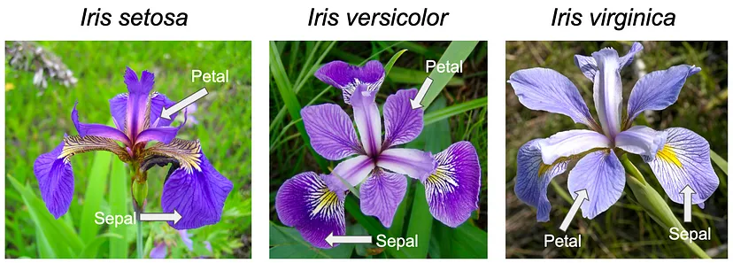
Pictures of the Three Flowers Species
https://ai.plainenglish.io/tackling-the-iris-classification-problem-with-k-nearest-neighbors-knn-b7d67afc9451

Slide 4
Statistics of Ratio Data
Stat / Features | sepal-length | sepal-width | petal-length | petal-width
count | 150.00 | 150.00 | 150.00 | 150.00
mean | 5.84 | 3.05 | 3.76 | 1.20
std | 0.82 | 0.43 | 1.76 | 0.76
min | 4.30 | 2.00 | 1.00 | 0.10
max | 7.90 | 4.40 | 6.90 | 2.50
25% | 5.10 | 2.80 | 1.60 | 0.30
50% | 5.80 | 3.00 | 4.35 | 1.30
75% | 6.40 | 3.30 | 5.10 | 1.80

Slide 5
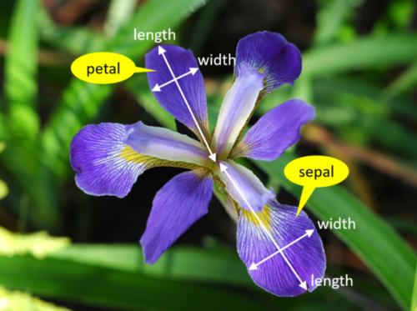
Data Features with Details of Iris Flowers
Numerical
Ratio | Definition | Range (cm.)
sepal-length | ความยาวกลีบเลี้ยง | 4.30 - 7.90
sepal-width | ความกว้างกลีบเลี้ยง | 2.00 - 4.40
petal-length | ความยาวกลีบดอก | 1.00 - 6.90
petal-width | ความกว้างกลีบดอก | 0.10 - 2.50
Categorical
Nominal | Consist Of
class | Iris-setosa, Iris-versicolor, Iris-virginica
https://www.integratedots.com/determine-number-of-iris-species-with-k-means/

Slide 6
Decision Tree

Slide 7
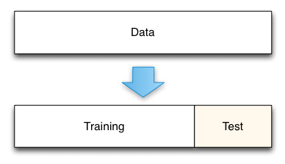
Split Ratio
140
10
https://medium.com/@rathinavel.mph/how-the-train-and-test-samples-are-split-d7e46a8e2361

Slide 8
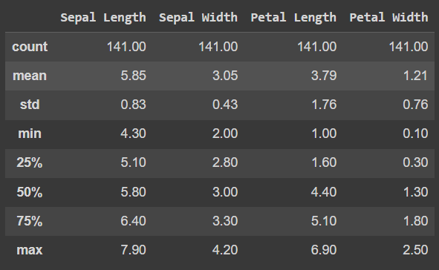
Train Dataset

Slide 9
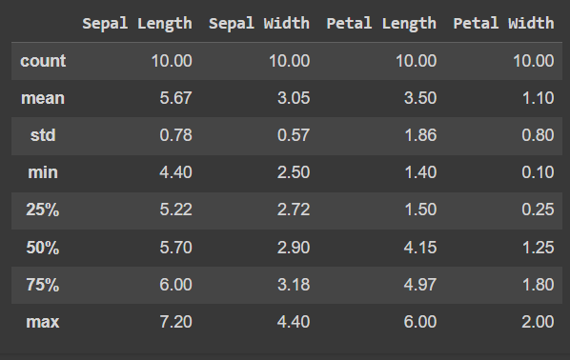
Test Dataset

Slide 10
Parameters in Decision Tree
Parameters | Tuning | Definition
criterion | gini | gini impurity measures the frequency at which any element of the dataset will be mislabelled when it is randomly labeled
 | entropy | entropy is a measure of information that indicates the disorder of the features with the target
splitter | best | choose the best split
min_samples_leaf | 5 | minimum number of samples required to split an internal node
min_samples_split | 2 | minimum number of samples required to be at a leaf node
https://quantdare.com/decision-trees-gini-vs-entropy/

Slide 11
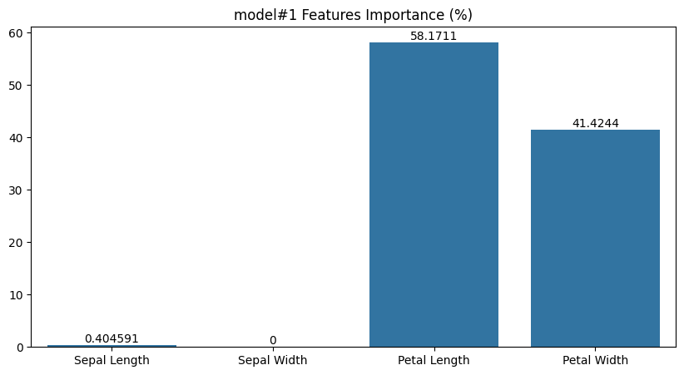
Train Model #1
Parameters
criterion | gini
splitter | best
min_samples_leaf | 5
Accuracy
train (df) | 1.0
test (df_test) | 1.0

Slide 12
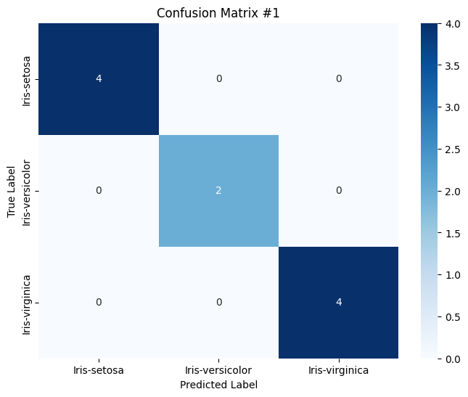

Slide 13
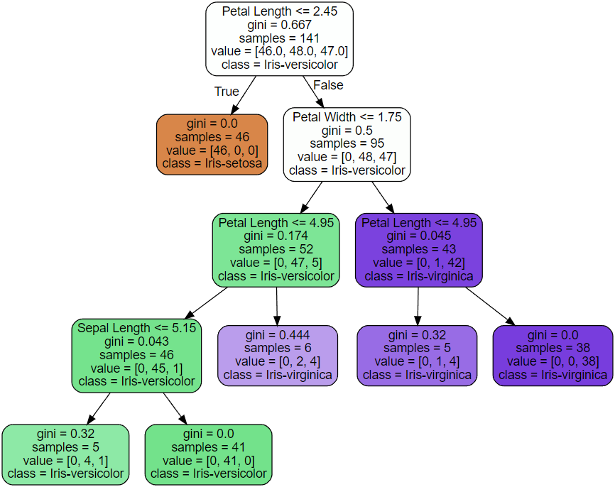

Slide 14
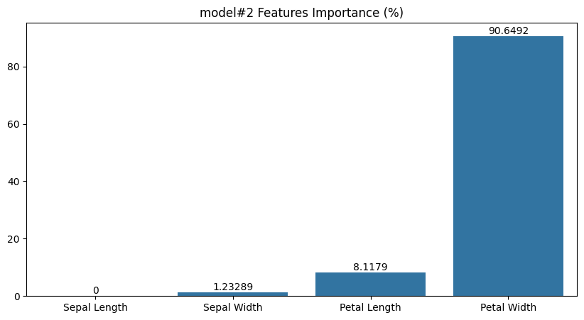
Train Model #2
Parameters
criterion | entropy
min_samples_split | 2
Accuracy
train (df) | 1.0
test (df_test) | 1.0

Slide 15
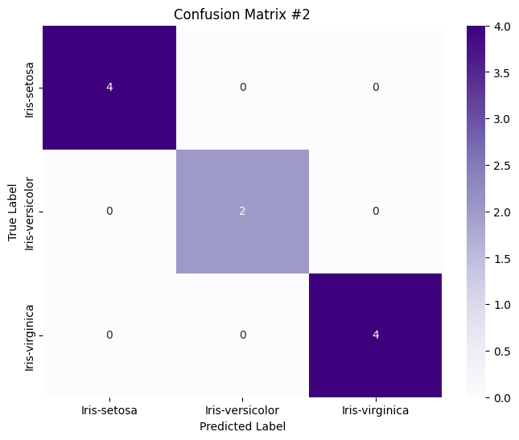

Slide 16
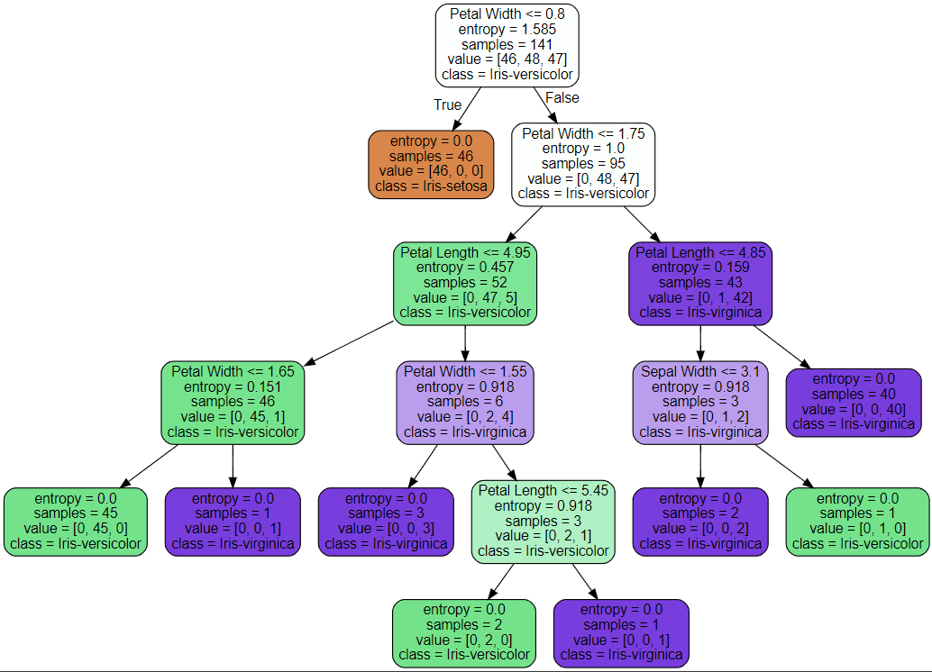

Slide 17
Random Forest

Slide 18
Split Ratio
80%
20%
https://medium.com/@rathinavel.mph/how-the-train-and-test-samples-are-split-d7e46a8e2361

Slide 19
Parameters in Random Forest
Parameters | Tuning | Definition
criterion | gini | gini impurity measures the frequency at which any element of the dataset will be mislabelled when it is randomly labeled
 | entropy | entropy is a measure of information that indicates the disorder of the features with the target
n_estimators | 100 | number of trees in the forest
max_depth | 5 | maximum depth of the tree
https://quantdare.com/decision-trees-gini-vs-entropy/

Slide 20
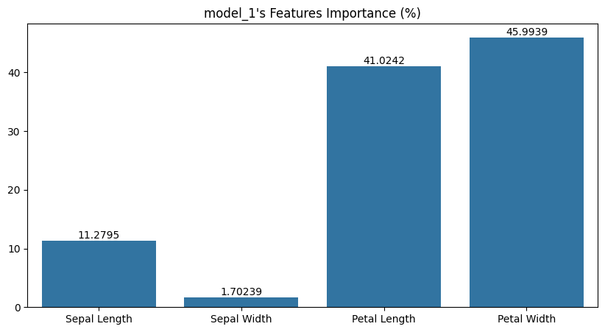
Train Model #1
Parameters
criterion | gini
n_estimators | 100
Accuracy
test | 0.933

Slide 21
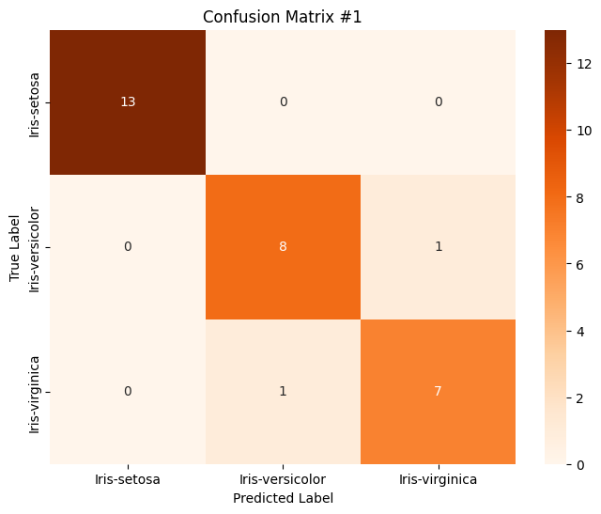

Slide 22
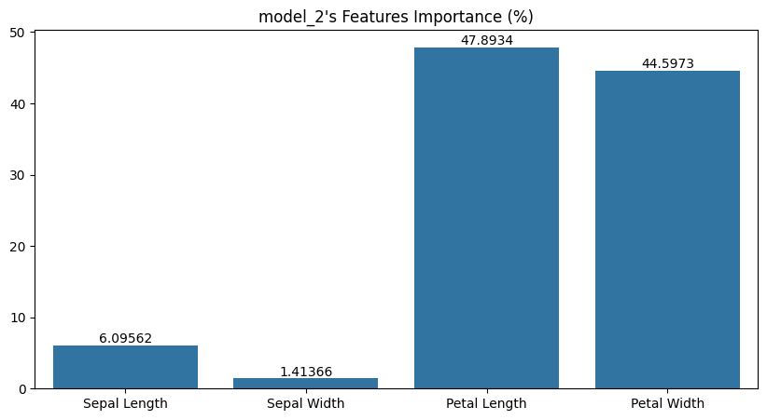
Train Model #2
Parameters
criterion | entropy
max_depth | 5
Accuracy
test | 0.966

Slide 23
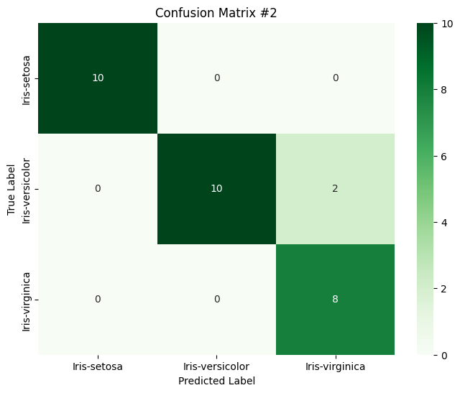

Slide 24
Thank You

